Slide 1
Deep Learning Tutorial
浙江大学计算机学院
人工智能研究所
汤斯亮
siliang@zju.edu.cn

Slide 2
Introduction

Slide 3
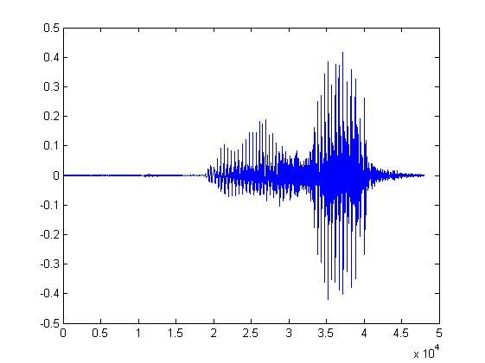

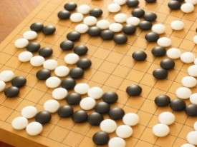
Machine Learning ≈ Looking for a Function
Speech Recognition
Image Recognition
Playing Go
Dialogue System
“How are you”
“Cat”
“5-5”
(next move)
“Hi”
“Hello”
(what the user said)
(system response)

Slide 4
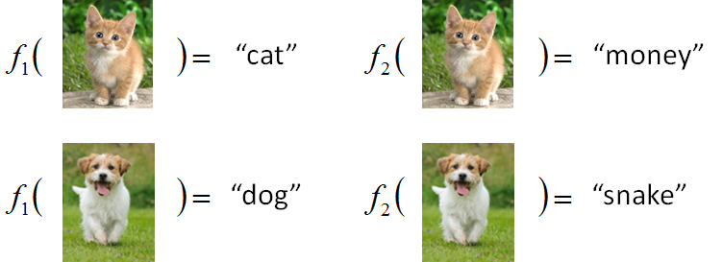
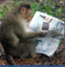
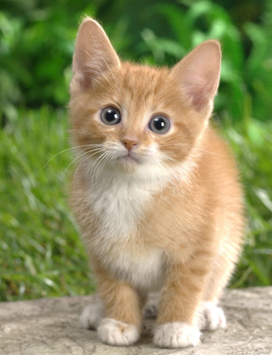

Framework
Image Recognition:
“cat”
A set of function
Model
Better!
Goodness of function f
Supervised Learning
function input:
Training
Data
function output:
“monkey”
“cat”
“dog”

Slide 5
Framework
Image Recognition:
“cat”
A set of function
Model
Training
Testing
“cat”
Step 1
Goodness of function f
Pick the “Best” Function
Using
Step 2
Step 3
Training
Data
“monkey”
“cat”
“dog”

Slide 6
Three Steps for Deep Learning
Step 1: define a set of function
Step 2: goodness of function
Step 3: pick the best function
Neural Network

Slide 7
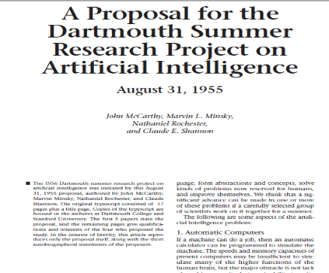
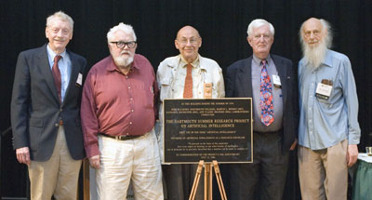
人工智能的诞生
四位学者在1955年提出了人工智能这一术语及研究范畴
John McCarthy (时任Dartmouth数学系助理教授，1971年度图灵奖获得者)
Marvin Lee Minsky (时任哈佛大学数学系和神经学系Junior Fellow，1969年度图灵奖获得)
Claude Shannon (Bell Lab, 信息理论之父)
Nathaniel Rochester(IBM, 第一代通用计算机701主设计师)
让机器能像人那样认知、思考和学习, 即用计算机模拟人的智能。
当年提出AI概念的建议书
AI概念提出50年后，建议人合影
Research Project on Artificial Intelligence , August 31, 1955, Dartmouth

Slide 8
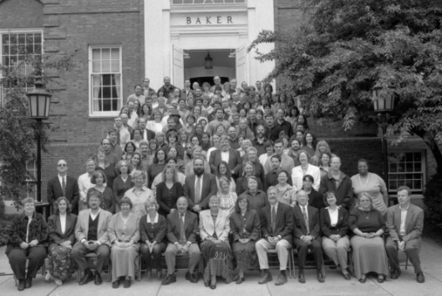
人工智能的诞生
报告列举了Artificial Intelligence所面临七类问题
Automatic Computers
How Can a Computer be Programmed to Use a Language
Neuron Nets
set of (hypothetical) neurons be arranged so as to form concepts
Theory of the Size of a Calculation
Self-improvement (自我学习与提高)
Abstractions
forming abstractions from sensory
Randomness and Creativity
The randomness must be guided by intuition to be efficient
达特茅斯会议合影 (1956年)

Slide 9
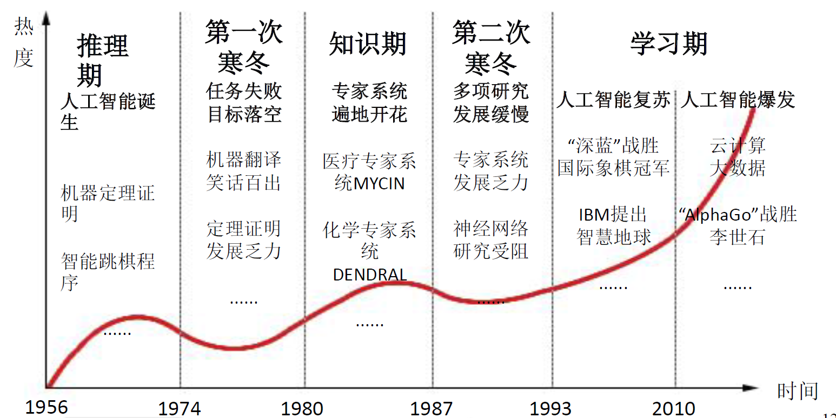
人工智能的曲折历程
AI的三次低谷

Slide 10
Neural Network
Neuron
A simple function
…
…
…
…
Activation function
weights
bias

Slide 11
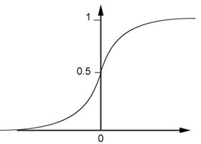
Neural Network
Neuron
Sigmoid Function
2
1
4
-1
-2
0.98
Activation function
-1
1
weights
1
bias

Slide 12
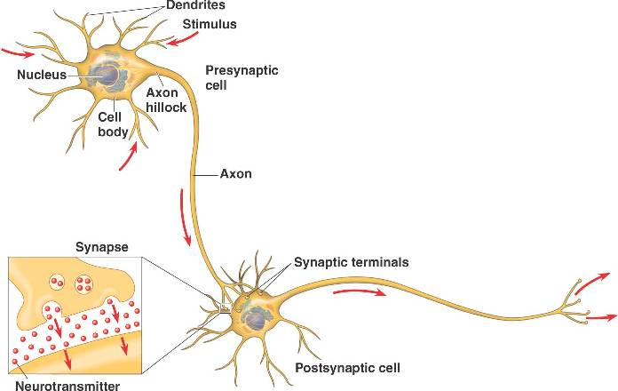
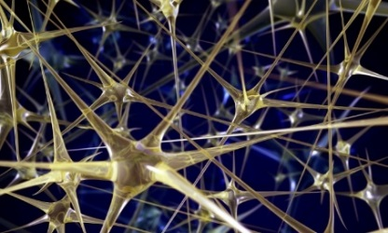

Neural Network
Different connections lead to different network structures
The neurons have different values of weights and biases.
Weights and biases are network parameters $θ$

Slide 13
Fully Connect Feedforward Network
1
4
0.98
1
-2
1
-1
-2
0.12
-1
1
0
Sigmoid Function

Slide 14
Fully Connect Feedforward Network
1
4
0.98
2
0.86
3
0.62
1
-2
-1
-1
1
0
-2
-1
-2
0.12
-2
0.11
-1
0.83
-1
1
-1
4
0
0
2

Slide 15
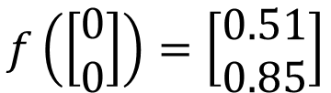
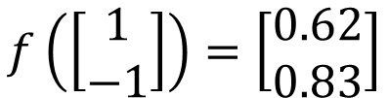

Fully Connect Feedforward Network
1
0.73
2
0.72
3
0.51
0
-2
-1
-1
1
0
-2
-1
0.5
-2
0.12
-1
0.85
0
1
-1
4
0
0
2
This is a function.
$$f\left(\left[\begin{matrix}1 \\ −1\end{matrix}\right]\right)=\left[\begin{matrix}0.62 \\ 0.83\end{matrix}\right]$$
$$f\left(\left[\begin{matrix}0 \\ 0\end{matrix}\right]\right)=\left[\begin{matrix}0.51 \\ 0.85\end{matrix}\right]$$
Input vector, output vector
Given parameters $θ$, define a function
Given network structure, define a function set

Slide 16
Fully Connect Feedforward Network
neuron
Input
Layer 1
Layer 2
Layer L
Output
……
y₁
……
y₂
……
……
……
……
……
……
y_{M}
Input Layer
Output Layer
Hidden Layers
Deep means many hidden layers

Slide 17
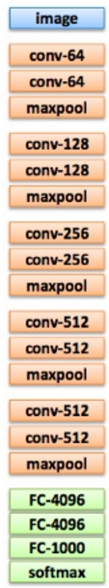
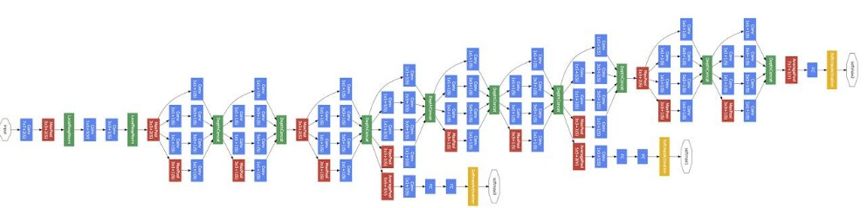
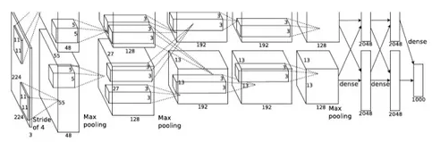
Deep = Many hidden layers
22 layers
http://cs231n.stanford.edu/slides/winter1516_lecture8.pdf
19 layers
8 layers
6.7%
7.3%
16.4%
AlexNet (2012)
VGG (2014)
GoogleNet (2014)

Slide 18
Deep = Many hidden layers
152 layers
Special
structure
3.57%
7.3%
6.7%
16.4%
Residual Net
(2015)
AlexNet (2012)
VGG
(2014)
GoogleNet
(2014)

Slide 19
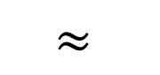
Why we need deep?
$$≈$$
Shallow & wide
the same number of parameters
Deep & Narrow
Less pieces
More pieces

Slide 20
Fully Connect Feedforward Network
neuron
Input
Layer 1
Layer 2
Layer L
Output
……
y₁
……
y₂
……
……
……
……
……
……
y_{M}
Input Layer
Output Layer
Hidden Layers

Slide 21
Output Layer
Softmax layer as the output layer
Ordinary Layer
In general, the output of network can be any value.
May not be easy to interpret

Slide 22
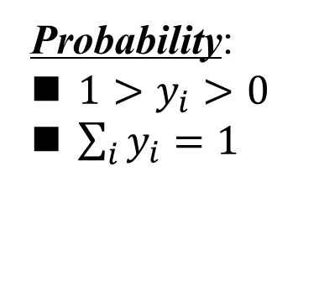
Output Layer
Probability:
$1>y_{i}>0$
$\sum_{i}{y_{i}=1}$
Softmax layer as the output layer
Softmax Layer
3
20
0.88
1
2.7
0.12
-3
0.05
≈0

Slide 23
Three Steps for Deep Learning
Step 1: define a set of function
Step 2: goodness of function
Step 3: pick the best function

Slide 24


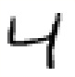





Training Data
Preparing training data: images and their labels
“5”
“0”
“4”
“1”
“9”
“2”
“1”
“3”
The learning target is defined on the training data.

Slide 25
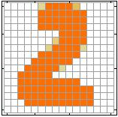


Learning Target
……
y₁
is 1
……
y₂
Softmax
is 2
……
……
……
……
y₁₀
is 0
16 x 16 = 256
Ink → 1
No ink → 0
The learning target is ……
Input:
y₁ has the maximum value
Input:
y₂ has the maximum value

Slide 26
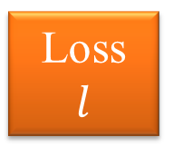
Loss
A good function should make the loss of all examples as small as possible.
“1”
……
y₁
1
As close as possible
……
y₂
Given a set of parameters
0
Softmax
……
……
……
……
……
Loss
$$l$$
……
y₁₀
0
Loss can be square error or cross entropy between the network output and target
target

Slide 27
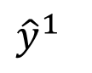
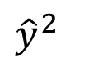
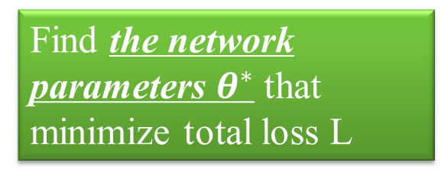
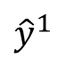
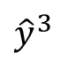
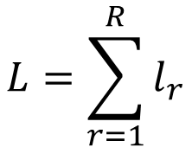
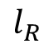
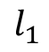
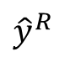
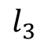
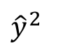
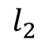
Total Loss
Total Loss:
$$L=\sum_{r=1}^{R}{l_{r}}$$
For all training data …
x¹
NN
y¹
$${\hat{y}}^{1}$$
$$l_{1}$$
As small as possible
x²
NN
y²
$${\hat{y}}^{2}$$
Find a function in function set that minimizes total loss L
$$l_{2}$$
x³
NN
y³
$${\hat{y}}^{3}$$
$$l_{3}$$
……
……
……
……
Find the network parameters $θ^{∗}$ that minimize total loss L
x^{R}
NN
y^{R}
$${\hat{y}}^{R}$$
$$l_{R}$$

Slide 28
Three Steps for Deep Learning
Step 1: define a set of function
Step 2: goodness of function
Step 3: pick the best function

Slide 29

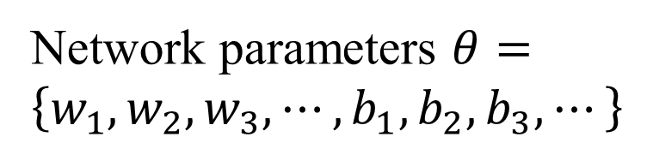
How to pick the best function
Find network parameters $θ^{∗}$ that minimize total loss L
Layer l
Layer l+1
Enumerate all possible values
Network parameters $θ=\left\{w_{1},w_{2},w_{3},⋯,b_{1},b_{2},b_{3},⋯\right\}$
10⁶
weights
……
……
Millions of parameters
E.g. speech recognition: 8 layers and 1000 neurons each layer
1000
neurons
1000
neurons

Slide 30
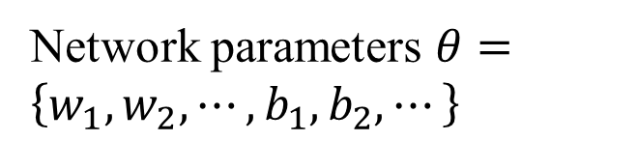
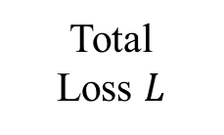
Gradient Descent
Network parameters $θ=\left\{w_{1},w_{2},⋯,b_{1},b_{2},⋯\right\}$
Find network parameters $θ^{∗}$ that minimize total loss L
Pick an initial value for w
Total
Loss $L$
Random, RBM pre-train
Usually good enough

Slide 31
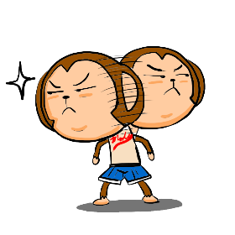
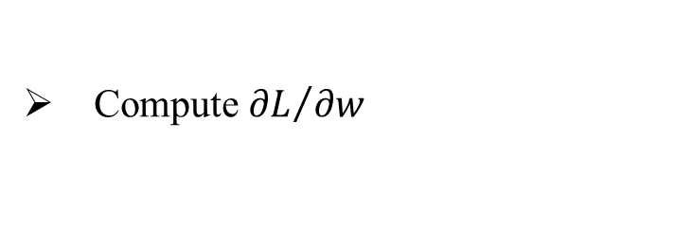
Gradient Descent
Network parameters $θ=\left\{w_{1},w_{2},⋯,b_{1},b_{2},⋯\right\}$
Find network parameters $θ^{∗}$ that minimize total loss L
Pick an initial value for w
Total
Loss $L$
Compute ${∂L}/{∂w}$
Negative
Increase w
Positive
Decrease w

Slide 32
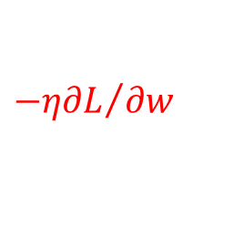
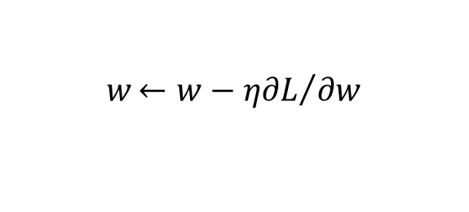
Gradient Descent
Network parameters $θ=\left\{w_{1},w_{2},⋯,b_{1},b_{2},⋯\right\}$
Find network parameters $θ^{∗}$ that minimize total loss L
Pick an initial value for w
Total
Loss $L$
Compute ${∂L}/{∂w}$
$$w{←w−η∂L}/{∂w}$$
Repeat
η is called “learning rate”
$${−η∂L}/{∂w}$$

Slide 33
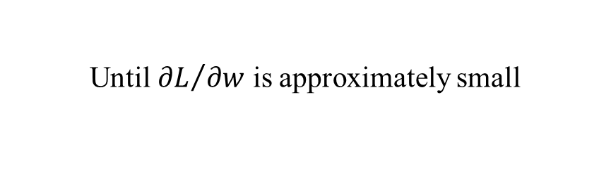
Gradient Descent
Network parameters $θ=\left\{w_{1},w_{2},⋯,b_{1},b_{2},⋯\right\}$
Find network parameters $θ^{∗}$ that minimize total loss L
Pick an initial value for w
Total
Loss $L$
Compute ${∂L}/{∂w}$
$$w{←w−η∂L}/{∂w}$$
Repeat
Until ${∂L}/{∂w}$ is approximately small
(when update is little)

Slide 34
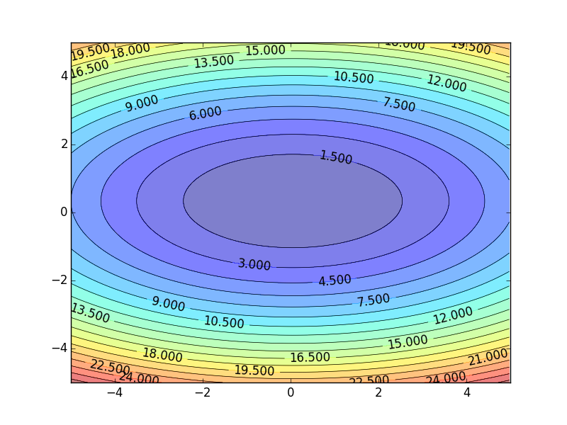
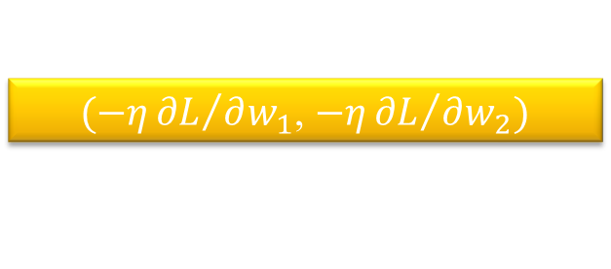
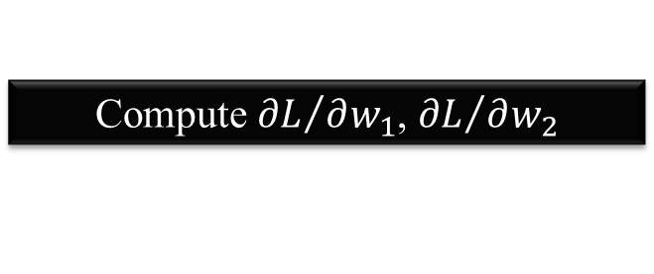
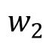
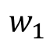
Gradient Descent
Hopfully, we would reach a minima …..
Color: Value of Total Loss L
$$w_{2}$$
$(−η{∂L}/{∂w_{1}}$, $−η{∂L}/{∂w_{2}})$
Compute ${∂L}/{∂w_{1}}$, ${∂L}/{∂w_{2}}$
$$w_{1}$$

Slide 35
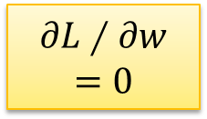
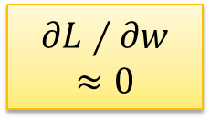

Local Minima
Total
Loss
Very slow at the plateau
Stuck at saddle point
Stuck at local minima
$$∂L∕∂w$$
$$≈0$$
$$∂L∕∂w$$
$$=0$$
$$∂L∕∂w$$
$$=0$$
The value of a network parameter w

Slide 36
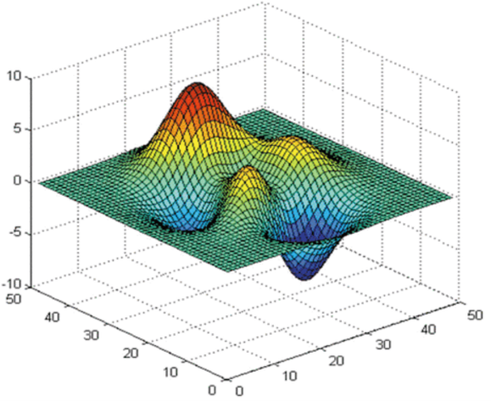



Local Minima
Gradient descent never guarantee global minima
Different initial point
$$L$$
Reach different minima, so different results
$$w_{1}$$
$$w_{2}$$

Slide 37


Gradient Descent
This is the “learning” of machines in deep learning ……
Even alpha go using this approach.
People image ……
Actually …..
I hope you are not too disappointed :p

Slide 38









Backpropagation
Backpropagation: an efficient way to compute ${∂L}/{∂w}$ in neural network

Slide 39
Variants of Neural Networks

Slide 40
Variants of Neural Networks
Convolutional Neural Network (CNN)
Recurrent Neural Network (RNN)
Widely used in image processing

Slide 41










Why CNN for Image?
[Zeiler, M. D., ECCV 2014]
……
……
……
……
……
……
Represented as pixels
……
The most basic classifiers
Use 1st layer as module to build classifiers
Use 2nd layer as module ……
Can the network be simplified by considering the properties of images?

Slide 42


Why CNN for Image
Some patterns are much smaller than the whole image
A neuron does not have to see the whole image to discover the pattern.
Connecting to small region with less parameters
“beak” detector

Slide 43


Why CNN for Image
The same patterns appear in different regions.
“upper-left beak” detector
Do almost the same thing
They can use the same set of parameters.
“middle beak” detector

Slide 44


Why CNN for Image
Subsampling the pixels will not change the object
bird
bird
subsampling
We can subsample the pixels to make image smaller
Less parameters for the network to process the image

Slide 45

The whole CNN
cat dog ……
Convolution
Max Pooling
Can repeat many times
Fully Connected Feedforward network
Convolution
Max Pooling
Flatten

Slide 46
The whole CNN
Property 1
Some patterns are much smaller than the whole image
Convolution
Property 2
Max Pooling
The same patterns appear in different regions.
Can repeat many times
Property 3
Convolution
Subsampling the pixels will not change the object
Max Pooling
Flatten

Slide 47
The whole CNN
cat dog ……
Convolution
Max Pooling
Can repeat many times
Fully Connected Feedforward network
Convolution
Max Pooling
Flatten

Slide 48
CNN – Convolution
Those are the network parameters to be learned.
1 | -1 | -1
-1 | 1 | -1
-1 | -1 | 1
1 | 0 | 0 | 0 | 0 | 1
0 | 1 | 0 | 0 | 1 | 0
0 | 0 | 1 | 1 | 0 | 0
1 | 0 | 0 | 0 | 1 | 0
0 | 1 | 0 | 0 | 1 | 0
0 | 0 | 1 | 0 | 1 | 0
Filter 1
Matrix
-1 | 1 | -1
-1 | 1 | -1
-1 | 1 | -1
Filter 2
Matrix
……
6 x 6 image
Each filter detects a small pattern (3 x 3).
Property 1

Slide 49
CNN – Convolution
1 | -1 | -1
-1 | 1 | -1
-1 | -1 | 1
Filter 1
stride=1
1 | 0 | 0 | 0 | 0 | 1
0 | 1 | 0 | 0 | 1 | 0
0 | 0 | 1 | 1 | 0 | 0
1 | 0 | 0 | 0 | 1 | 0
0 | 1 | 0 | 0 | 1 | 0
0 | 0 | 1 | 0 | 1 | 0
3
-1
6 x 6 image

Slide 50
CNN – Convolution
1 | -1 | -1
-1 | 1 | -1
-1 | -1 | 1
Filter 1
If stride=2
1 | 0 | 0 | 0 | 0 | 1
0 | 1 | 0 | 0 | 1 | 0
0 | 0 | 1 | 1 | 0 | 0
1 | 0 | 0 | 0 | 1 | 0
0 | 1 | 0 | 0 | 1 | 0
0 | 0 | 1 | 0 | 1 | 0
3
-3
We set stride=1 below
6 x 6 image

Slide 51
CNN – Convolution
1 | -1 | -1
-1 | 1 | -1
-1 | -1 | 1
Filter 1
stride=1
1 | 0 | 0 | 0 | 0 | 1
0 | 1 | 0 | 0 | 1 | 0
0 | 0 | 1 | 1 | 0 | 0
1 | 0 | 0 | 0 | 1 | 0
0 | 1 | 0 | 0 | 1 | 0
0 | 0 | 1 | 0 | 1 | 0
3
-1
-3
-1
-3
1
0
-3
-3
-3
0
1
3
-2
-2
-1
6 x 6 image
Property 2

Slide 52
CNN – Convolution
-1 | 1 | -1
-1 | 1 | -1
-1 | 1 | -1
Filter 2
stride=1
Do the same process for every filter
1 | 0 | 0 | 0 | 0 | 1
0 | 1 | 0 | 0 | 1 | 0
0 | 0 | 1 | 1 | 0 | 0
1 | 0 | 0 | 0 | 1 | 0
0 | 1 | 0 | 0 | 1 | 0
0 | 0 | 1 | 0 | 1 | 0
3
-1
-3
-1
-1
-1
-1
-1
-3
1
0
-3
-1
-1
-2
1
Feature
Map
-3
-3
0
1
-1
-1
-2
1
3
-2
-2
-1
6 x 6 image
-1
0
-4
3
4 x 4 image

Slide 53
CNN – Zero Padding
1 | -1 | -1
-1 | 1 | -1
-1 | -1 | 1
Filter 1
0
0
0
0
1 | 0 | 0 | 0 | 0 | 1
0 | 1 | 0 | 0 | 1 | 0
0 | 0 | 1 | 1 | 0 | 0
1 | 0 | 0 | 0 | 1 | 0
0 | 1 | 0 | 0 | 1 | 0
0 | 0 | 1 | 0 | 1 | 0
0
You will get another 6 x 6 images in this way
0
0
Zero padding
0
0
0
6 x 6 image

Slide 54

CNN – Colorful image
1 | -1 | -1
-1 | 1 | -1
-1 | -1 | 1
-1 | 1 | -1
-1 | 1 | -1
-1 | 1 | -1
1 | -1 | -1
-1 | 1 | -1
-1 | -1 | 1
-1 | 1 | -1
-1 | 1 | -1
-1 | 1 | -1
1 | -1 | -1
-1 | 1 | -1
-1 | -1 | 1
-1 | 1 | -1
-1 | 1 | -1
-1 | 1 | -1
Filter 1
Filter 2
Colorful image
1 | 0 | 0 | 0 | 0 | 1
0 | 1 | 0 | 0 | 1 | 0
0 | 0 | 1 | 1 | 0 | 0
1 | 0 | 0 | 0 | 1 | 0
0 | 1 | 0 | 0 | 1 | 0
0 | 0 | 1 | 0 | 1 | 0
1 | 0 | 0 | 0 | 0 | 1
0 | 1 | 0 | 0 | 1 | 0
0 | 0 | 1 | 1 | 0 | 0
1 | 0 | 0 | 0 | 1 | 0
0 | 1 | 0 | 0 | 1 | 0
0 | 0 | 1 | 0 | 1 | 0
1 | 0 | 0 | 0 | 0 | 1
0 | 1 | 0 | 0 | 1 | 0
0 | 0 | 1 | 1 | 0 | 0
1 | 0 | 0 | 0 | 1 | 0
0 | 1 | 0 | 0 | 1 | 0
0 | 0 | 1 | 0 | 1 | 0

Slide 55

Convolution v.s. Fully Connected
1 | 0 | 0 | 0 | 0 | 1
0 | 1 | 0 | 0 | 1 | 0
0 | 0 | 1 | 1 | 0 | 0
1 | 0 | 0 | 0 | 1 | 0
0 | 1 | 0 | 0 | 1 | 0
0 | 0 | 1 | 0 | 1 | 0
1 | -1 | -1
-1 | 1 | -1
-1 | -1 | 1
-1 | 1 | -1
-1 | 1 | -1
-1 | 1 | -1
convolution
image
1 | 0 | 0 | 0 | 0 | 1
0 | 1 | 0 | 0 | 1 | 0
0 | 0 | 1 | 1 | 0 | 0
1 | 0 | 0 | 0 | 1 | 0
0 | 1 | 0 | 0 | 1 | 0
0 | 0 | 1 | 0 | 1 | 0
Fully-connected
……
……

Slide 56

1 | -1 | -1
-1 | 1 | -1
-1 | -1 | 1
1:
1
Filter 1
2:
0
3:
0
3
4:
0
1 | 0 | 0 | 0 | 0 | 1
0 | 1 | 0 | 0 | 1 | 0
0 | 0 | 1 | 1 | 0 | 0
1 | 0 | 0 | 0 | 1 | 0
0 | 1 | 0 | 0 | 1 | 0
0 | 0 | 1 | 0 | 1 | 0
…
7:
0
8:
1
9:
0
10:
0
…
13:
0
6 x 6 image
14:
0
Less parameters!
15:
Only connect to 9 input, not fully connected
1
16:
1
…

Slide 57

1 | -1 | -1
-1 | 1 | -1
-1 | -1 | 1
1:
1
Filter 1
2:
0
3:
0
3
4:
0
1 | 0 | 0 | 0 | 0 | 1
0 | 1 | 0 | 0 | 1 | 0
0 | 0 | 1 | 1 | 0 | 0
1 | 0 | 0 | 0 | 1 | 0
0 | 1 | 0 | 0 | 1 | 0
0 | 0 | 1 | 0 | 1 | 0
…
7:
0
8:
1
-1
9:
0
10:
0
…
13:
0
6 x 6 image
14:
0
Less parameters!
15:
1
16:
1
Shared weights
Even less parameters!
…

Slide 58
The whole CNN
cat dog ……
Convolution
Max Pooling
Can repeat many times
Fully Connected Feedforward network
Convolution
Max Pooling
Flatten

Slide 59
CNN – Max Pooling
1 | -1 | -1
-1 | 1 | -1
-1 | -1 | 1
-1 | 1 | -1
-1 | 1 | -1
-1 | 1 | -1
Filter 1
Filter 2
3
-1
-3
-1
-1
-1
-1
-1
-3
1
0
-3
-1
-1
-2
1
-3
-3
0
1
-1
-1
-2
1
3
-2
-2
-1
-1
0
-4
3

Slide 60
CNN – Max Pooling
New image
but smaller
1 | 0 | 0 | 0 | 0 | 1
0 | 1 | 0 | 0 | 1 | 0
0 | 0 | 1 | 1 | 0 | 0
1 | 0 | 0 | 0 | 1 | 0
0 | 1 | 0 | 0 | 1 | 0
0 | 0 | 1 | 0 | 1 | 0
Conv
3
0
-1
1
Max
Pooling
3
1
0
3
2 x 2 image
6 x 6 image
Each filter
is a channel

Slide 61
The whole CNN
3
0
-1
1
Convolution
3
1
0
3
Max Pooling
Can repeat many times
A new image
Convolution
Smaller than the original image
The number of the channel is the number of filters
Max Pooling

Slide 62
The whole CNN
cat dog ……
Convolution
Max Pooling
A new image
Fully Connected Feedforward network
Convolution
Max Pooling
A new image
Flatten

Slide 63
Flatten
3
0
1
3
0
-1
1
3
3
1
-1
0
3
Flatten
1
Fully Connected Feedforward network
0
3

Slide 64

More Application: Playing Go
Network
Next move
(19 x 19 positions)
19 x 19 matrix (image)
19 x 19 vector
19 x 19 vector
Fully-connected feedforward network can be used
Black: 1
white: -1
none: 0
But CNN performs much better.

Slide 65


Why CNN for playing Go?
Some patterns are much smaller than the whole image
The same patterns appear in different regions.
Alpha Go uses 5 x 5 for first layer

Slide 66
Variants of Neural Networks
Convolutional Neural Network (CNN)
Recurrent Neural Network (RNN)
Neural Network with Memory

Slide 67

Recurrent Neural Network
Given function f: $h^{′},y=f\left(h,x\right)$
h and h’ are vectors with the same dimension
y¹
y²
y³
h⁰
f
h¹
f
h²
f
h³
……
x¹
x²
x³
No matter how long the input/output sequence is, we only need one function f

Slide 68



Deep RNN
$$h^{′},y=f_{1}\left(h,x\right)$$
$$b^{′},c=f_{2}\left(b,y\right)$$
$$…$$
…
…
…
c¹
c²
c³
b⁰
f₂
b¹
f₂
b²
f₂
b³
……
y¹
y²
y³
h⁰
f₁
h¹
f₁
h²
f₁
h³
……
x¹
x²
x³

Slide 69



Bidirectional RNN
$$h^{′},a=f_{1}\left(h,x\right)$$
$$b^{′},c=f_{2}\left(b,x\right)$$
x¹
x²
x³
b⁰
f₂
b¹
f₂
b²
f₂
b³
c¹
c²
c³
y¹
y²
y³
$$y=f_{3}\left(a,c\right)$$
f₃
f₃
f₃
a¹
a²
a³
h⁰
f₁
h¹
f₁
h²
f₁
h³
x¹
x²
x³

Slide 70


Naïve RNN
Given function f: $h^{′},y=f\left(h,x\right)$
y
h'
W^{h}
h
W^{i}
x
$$+$$
$$=σ\left( \right)$$
h
f
h'
y
Wº
h'
$$=σ\left( \right)$$
x
softmax
Ignore bias here

Slide 71
LSTM
y^{t}
LSTM
c^{t}
y^{t}
c^{t-1}
Naive
h^{t}
h^{t}
h^{t-1}
h^{t-1}
x^{t}
x^{t}
c changes slowly
c^{t} is c^{t-1} added by something
h changes faster
h^{t} and h^{t-1} can be very different

Slide 72





x^{t}
z
W
$$=tanh\left( \right)$$
h^{t-1}
c^{t-1}
x^{t}
z^{i}
W^{i}
$$=σ\left( \right)$$
h^{t-1}
Input
gate
x^{t}
z^{f}
W^{f}
$$=σ\left( \right)$$
h^{t-1}
z^{f}
z^{i}
z
zº
forget
gate
x^{t}
zº
Wº
$$=σ\left( \right)$$
h^{t-1}
x^{t}
h^{t-1}
output
gate

Slide 73

x^{t}
z
W
h^{t-1}
$$=tanh\left( \right)$$
c^{t-1}
c^{t-1}
diagonal
“peephole”
zº
z^{f}
z^{i}
obtained by the same way
z^{f}
z^{i}
z
zº
h^{t-1}
x^{t}

Slide 74








y^{t}
c^{t-1}
c^{t}
$$⨀$$
$$＋$$
$$⨀$$
$$c^{t}=z^{f}⨀c^{t−1}$$
$$+z^{i}⨀z$$
$$⨀$$
$$h^{t}=z^{o}⨀tanh\left(c^{t}\right)$$
z^{f}
z^{i}
z
zº
$$y^{t}=σ\left(W^{′}h^{t}\right)$$
h^{t-1}
x^{t}
h^{t}

Slide 75








LSTM
y^{t}
y^{t+1}
c^{t-1}
c^{t}
c^{t+1}
$$⨀$$
$$＋$$
$$⨀$$
$$⨀$$
$$＋$$
$$⨀$$
$$⨀$$
$$⨀$$
z^{f}
z^{i}
z
zº
z^{f}
z^{i}
z
zº
h^{t+1}
h^{t-1}
x^{t}
h^{t}
x^{t+1}

Slide 76







GRU
$$h^{t}=z⨀h^{t−1}+\left(1−z\right)⨀h^{′}$$
y^{t}
h^{t-1}
$$⨀$$
$$＋$$
h^{t}
$$⨀$$
1-
$$⨀$$
reset
update
r
z
h'
h^{t-1}
x^{t}
x^{t}

Slide 77

LSTM: A Search Space Odyssey

Slide 78


LSTM: A Search Space Odyssey
Standard LSTM works well
Simply LSTM: coupling input and forget gate, removing peephole
Forget gate is critical for performance
Output gate activation function is critical

Slide 79
Sequence Generation

Slide 80
Generation
Sentences are composed of characters/words
Generating a character/word at each time by RNN
你
我
他
是
很
x:
0
1
0
0
0
……
0
y:
0
0
0
0.7
0.3
……
0
y
Distribution over the token
(sampling from the distribution to generate a token)
h
f
h'
x
The token generated at the last time step.
(represented by 1-of-N encoding)

Slide 81



Generation
Sentences are composed of characters/words
Generating a character/word at each time by RNN
床
前
明
sample, argmax
$$\sim$$
$$\sim$$
$$\sim$$
Until <EOS> is generated
y¹
y²
y³
h⁰
f
h¹
f
h²
f
h³
……
x¹
x²
x³
<BOS>
床
前

Slide 82
Generation
Training
Training data: 春眠不觉晓
春
眠
不
y¹
y²
y³
h⁰
f
h¹
f
h²
f
h³
……
x¹
x²
x³
<BOS>
春
眠

Slide 83



Conditional Generation
We don’t want to simply generate some random sentences.
Generate sentences based on conditions:
Caption Generation
Given condition:
“A young girl is dancing.”
Chat-bot
“Hello”
“Hello. Nice to see you.”
Given condition:

Slide 84


Conditional Generation
Represent the input condition as a vector, and consider the vector as the input of RNN generator
Image Caption Generation
A
woman
. (period)
A vector
<BOS>
CNN
……
Input image

Slide 85
Conditional Generation
Represent the input condition as a vector, and consider the vector as the input of RNN generator
E.g. Machine translation / Chat-bot
Sequence-to-sequence learning
machine
learning
. (period)
Information of the whole sentences
机
器
学
习
Encoder
Jointly train
Decoder

Slide 86









Dynamic Conditional Generation
$$c^{1}$$
$$c^{2}$$
machine
learning
. (period)
$$h^{1}$$
$$h^{2}$$
$$h^{3}$$
$$h^{4}$$
机
器
学
习
$$c^{1}$$
$$c^{2}$$
$$c^{3}$$
Encoder
Decoder

Slide 87










Machine Translation
$$α$$
Jointly learned with other part of the network
Attention-based model
match
$$h$$
$$z$$
$$α_{0}^{1}$$
match
What is ?
match
$$z^{0}$$
Design by yourself
Cosine similarity of z and h
$$h^{1}$$
$$h^{2}$$
$$h^{3}$$
$$h^{4}$$
Small NN whose input is z and h, output a scalar
机
器
学
习
$α=h^{T}Wz$

Slide 88


















Machine Translation
Attention-based model
machine
$$c^{0}$$
0.5
$${\hat{α}}_{0}^{1}$$
0.5
$${\hat{α}}_{0}^{2}$$
0.0
$${\hat{α}}_{0}^{3}$$
0.0
$${\hat{α}}_{0}^{4}$$
$$z^{0}$$
$$z^{1}$$
softmax
$$α_{0}^{1}$$
$$α_{0}^{2}$$
$$α_{0}^{3}$$
$$α_{0}^{4}$$
$$c^{0}$$
Decoder input
$$h^{1}$$
$$h^{2}$$
$$h^{3}$$
$$h^{4}$$
$$c^{0}=\sum{{\hat{α}}_{0}^{i}h^{i}}$$
机
器
学
习
$$=0.5h^{1}+0.5h^{2}$$
Notes:
Word vector

Slide 89








Machine Translation
Attention-based model
machine
$$α_{1}^{1}$$
match
$$z^{0}$$
$$z^{1}$$
$$c^{0}$$
$$h^{1}$$
$$h^{2}$$
$$h^{3}$$
$$h^{4}$$
机
器
学
习

Slide 90




















Machine Translation
Attention-based model
machine
learning
$$c^{1}$$
0.0
$${\hat{α}}_{1}^{1}$$
0.0
$${\hat{α}}_{1}^{2}$$
0.5
$${\hat{α}}_{1}^{3}$$
0.5
$${\hat{α}}_{1}^{4}$$
$$z^{0}$$
$$z^{1}$$
$$z^{2}$$
softmax
$$α_{1}^{1}$$
$$α_{1}^{2}$$
$$α_{1}^{3}$$
$$α_{1}^{4}$$
$$c^{0}$$
$$c^{1}$$
$$h^{1}$$
$$h^{2}$$
$$h^{3}$$
$$h^{4}$$
$$c^{1}=\sum{{\hat{α}}_{1}^{i}h^{i}}$$
机
器
学
习
$$=0.5h^{3}+0.5h^{4}$$

Slide 91









Machine Translation
Attention-based model
machine
learning
……
$$α_{2}^{1}$$
……
match
$$z^{0}$$
$$z^{1}$$
$$z^{2}$$
$$c^{0}$$
$$c^{1}$$
……
$$h^{1}$$
$$h^{2}$$
$$h^{3}$$
$$h^{4}$$
The same process repeat until generating
机
器
学
习
<EOS>

Slide 92

谢谢！
办公室地址：浙江大学玉泉校区则通楼205
电话：13588196277
邮件：siliang@zju.edu.cn
微信号：siliangtang（or手机号码）

